Slide 1


Introduction
ACCESSDATA® FORENSICS
NARROWING YOUR FOCUS
Forensic Analysis
Incident Response
eDiscovery
Information Assurance

Slide 2
Module Objectives
Narrowing Evidence Items
  KFF Management
  Fuzzy Hashing
  Checked Items
  Ignored / Privileged Items
Searching
  Indexed Search
  Import Lists
  Live Search
  Regular Expressions

Slide 3
Known File Filter (KFF)
The KFF is a database utility that compares known file hash values against your case files.
Using the KFF during your analysis:
  Can immediately identify and ignore 40-70% of files.
  Can immediately identify known contraband files.
  Remember: Hash is based on data, not names or extension

Slide 4
KFF Management
KFF is maintained by the database.
Sets are imported from many sources.
Duplicate hash values are allowed.
Sets are placed in groups to run against the data.
Available sets may be assigned to more than one group.

Slide 5
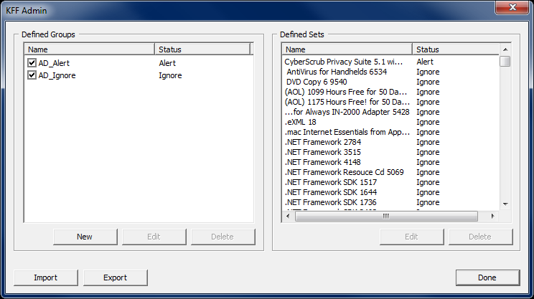
KFF Management
Default Groups Contain Hashes from:
NSRL from NIST
HashKeeper from NDIC
Department of Homeland Security

Slide 6
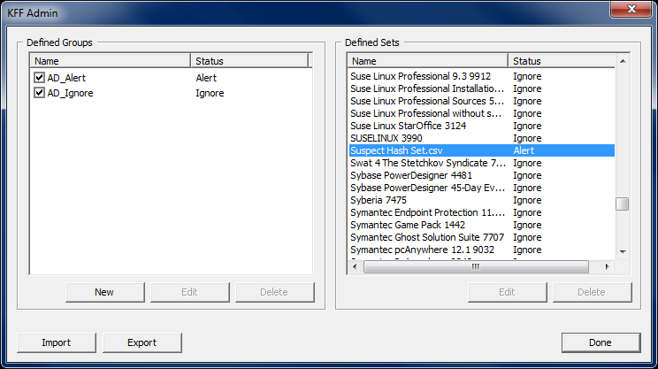
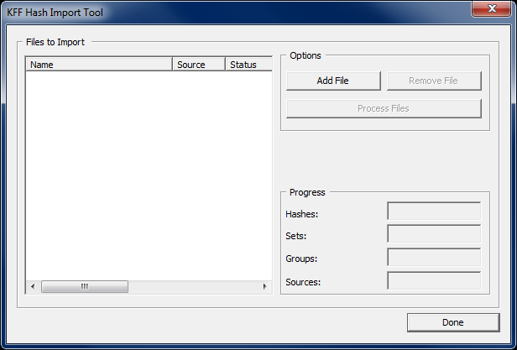
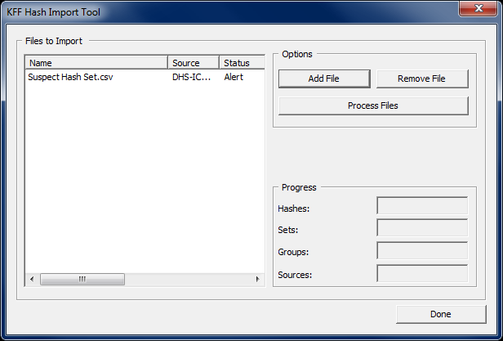
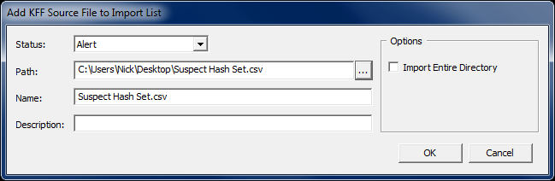
Importing Hash Sets

Slide 7
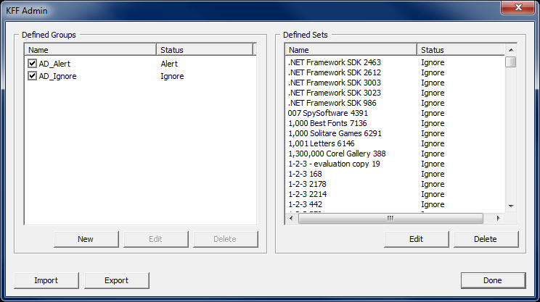
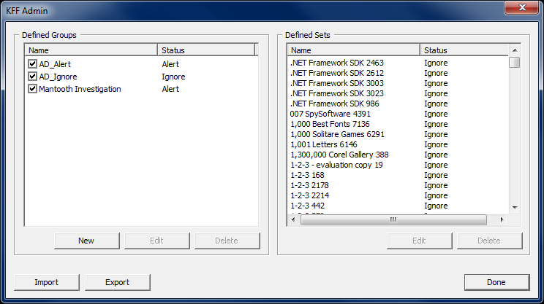
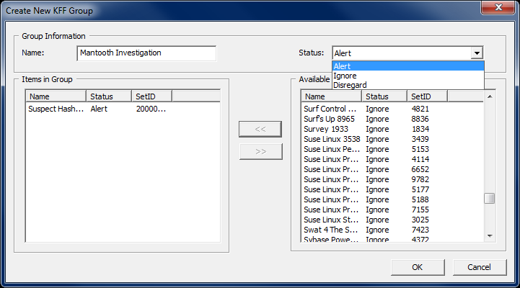
Defining Groups
You must check it to use it!

Slide 8
Fuzzy Hashing
Fuzzy hashing identifies files that are similar but not exact equals, called homologous files.
FTK can compare live documents active in the file system and partial files recovered from unallocated space or slack space.
Only actual files are fuzzy hashed. Directories, unallocated/unpartitioned space, etc., are not hashed.
Encrypted Files are not fuzzy hashed.

Slide 9
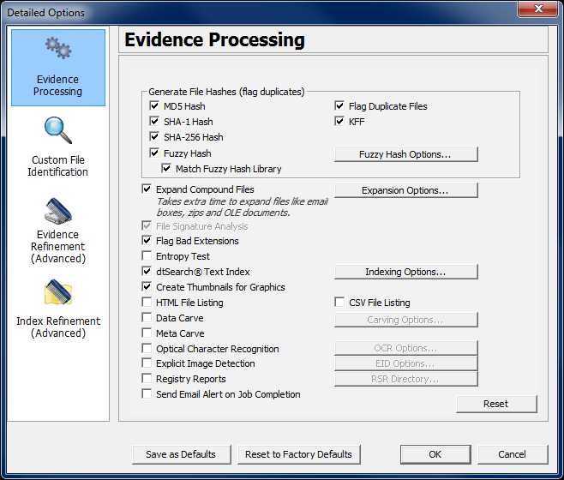
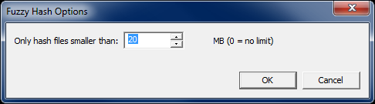
Generating Fuzzy Hash Values
Fuzzy Hash values can be generated for all files in the case during Evidence Processing

Slide 10
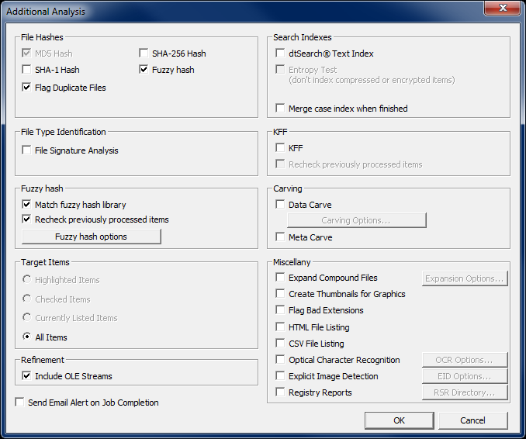
Generating Fuzzy Hash Values
Fuzzy Hash values can be generated after the case has been processing by using Additional Analysis

Slide 11
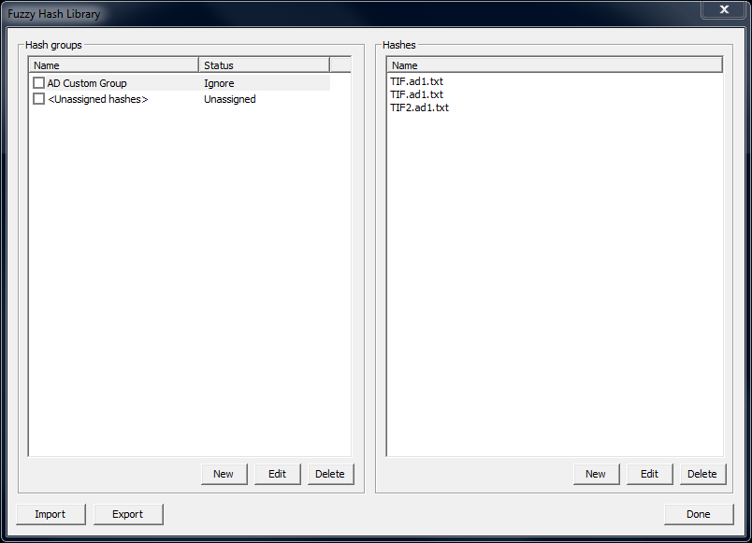
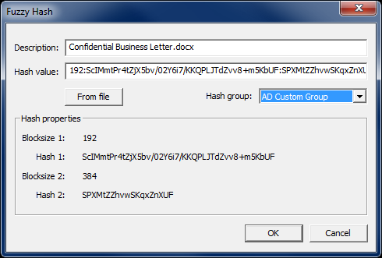
Fuzzy Hash Library
Fuzzy hash libraries are collections of fuzzy hashes that can be used to identify evidence that is similar in content.
Add files to the Fuzzy Hash Library by right-clicking then clicking Add to Fuzzy Hash Library

Slide 12
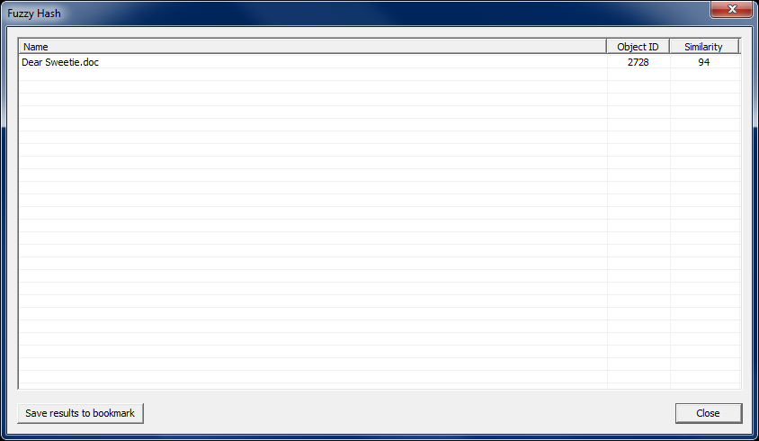
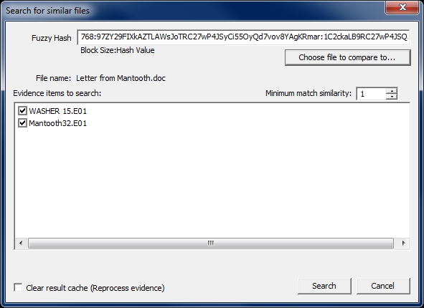
Find Similar Files

Slide 13
Checked Items
Use Checked Items to perform special functions
Bookmarking
Exporting
Copy Special / Export File List
Ignore / Flag Privileged
Additional Analysis
Searching

Slide 14
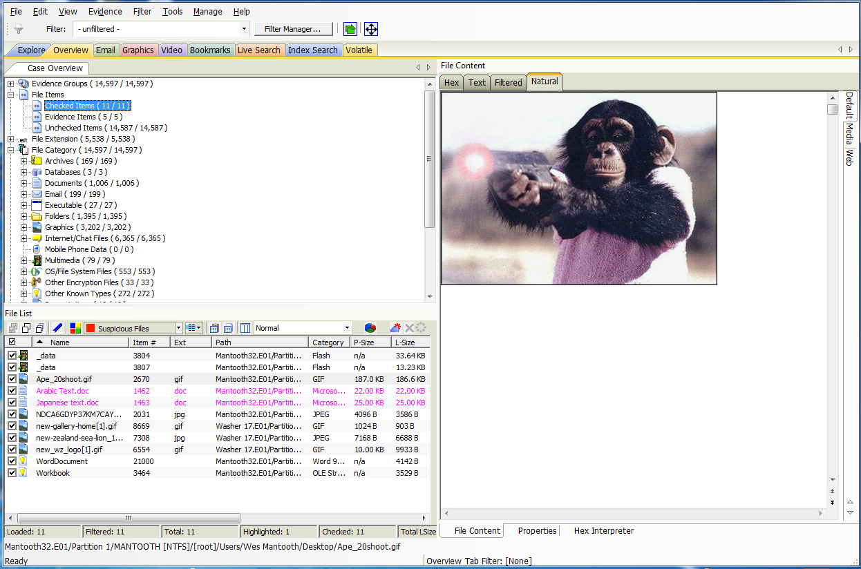
Checked Items
Review Checked Files in the Case
Overview Tab > File Items > Checked Items

Slide 15
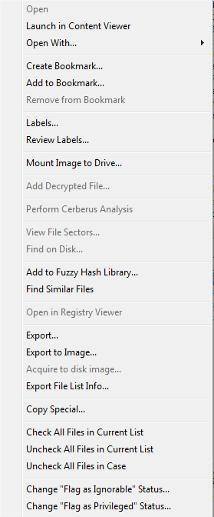
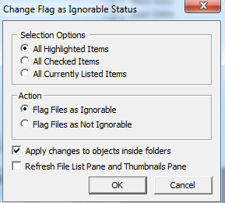
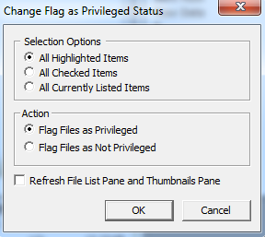
Changing Flags
Reviewers can’t ignore files
Reviewers can’t see Privileged

Slide 16
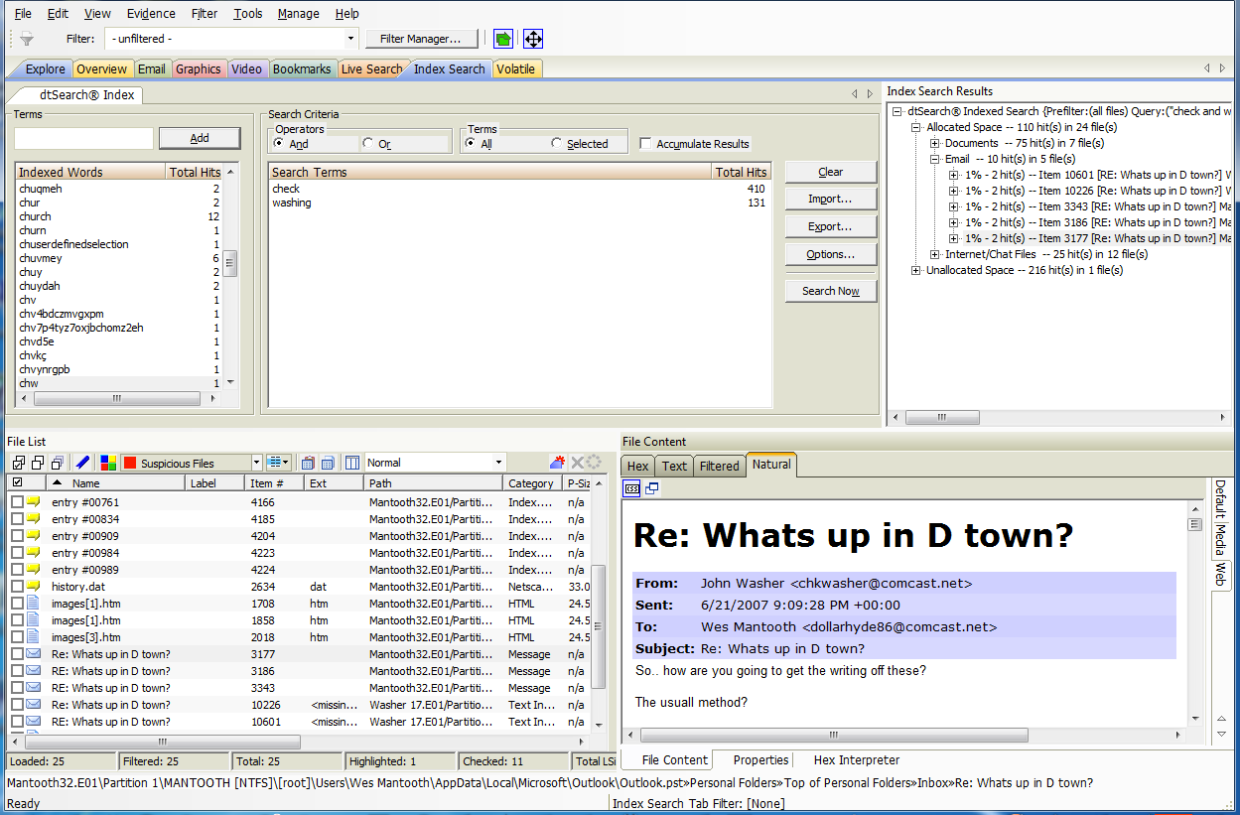
Indexed Searching

Slide 17
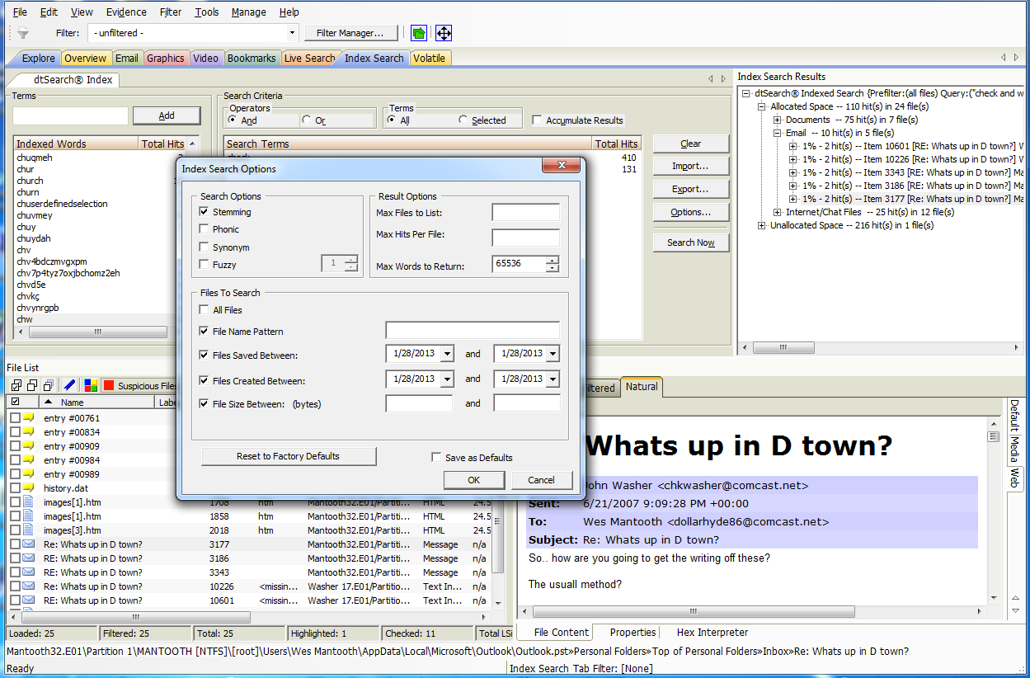
Indexed Search Options

Slide 18
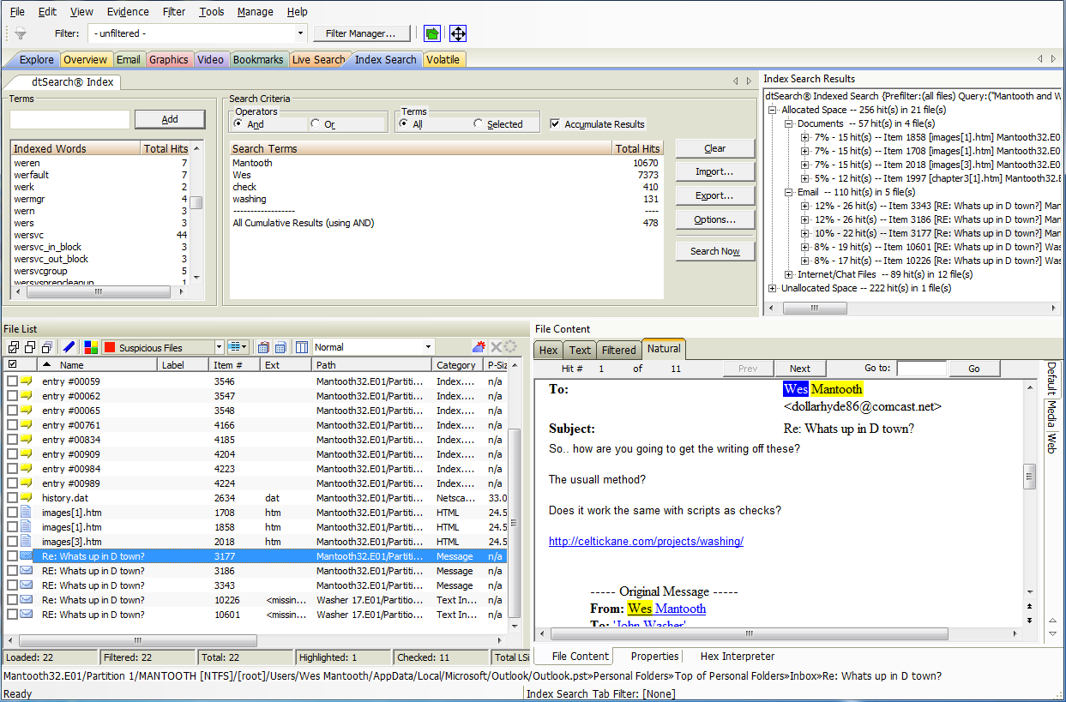
Import Lists

Slide 19
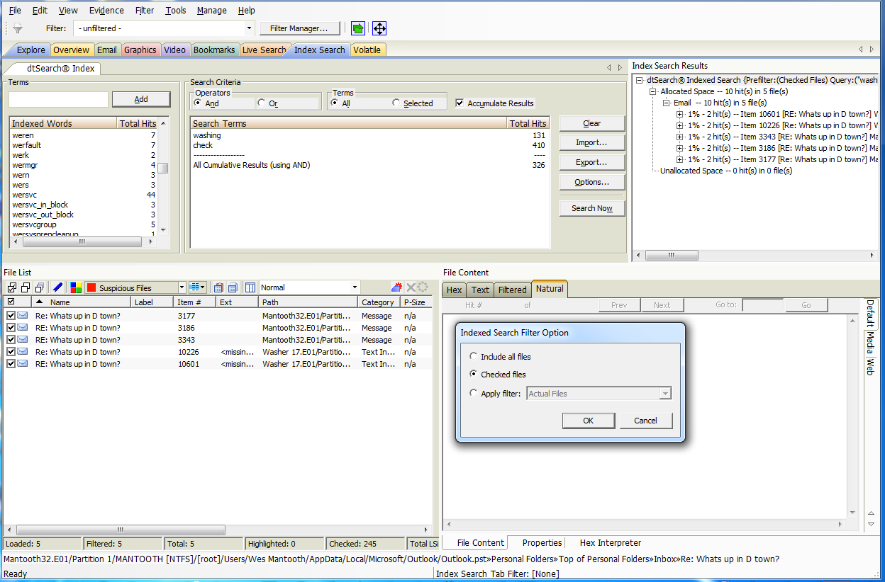
Searching Checked Items

Slide 20
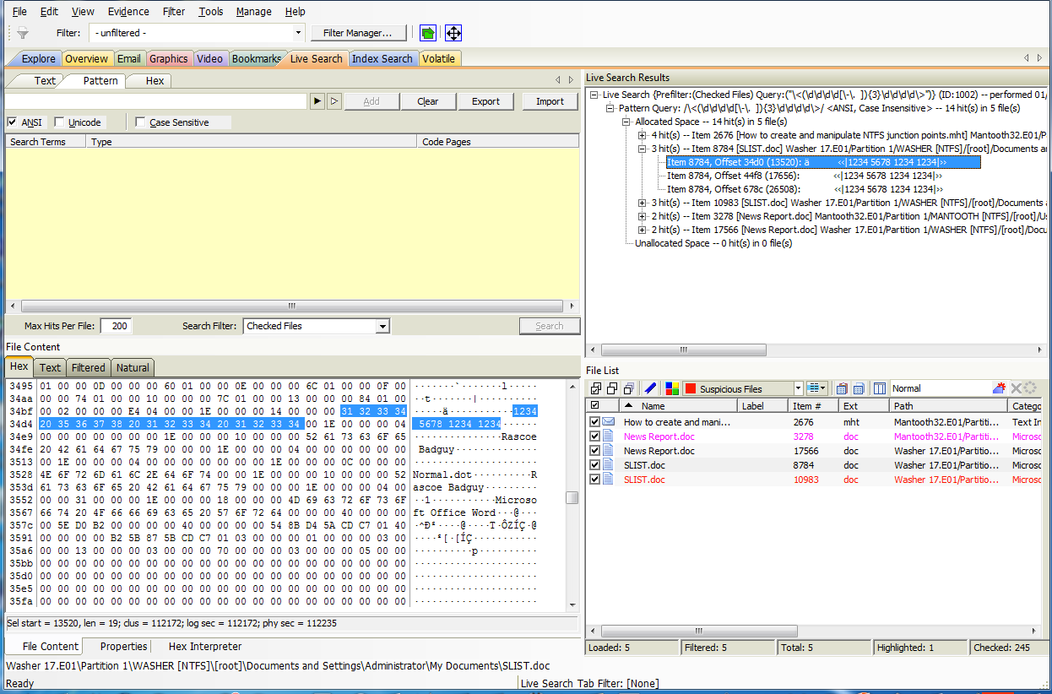
Live Search

Slide 21
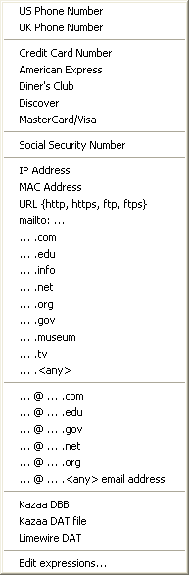
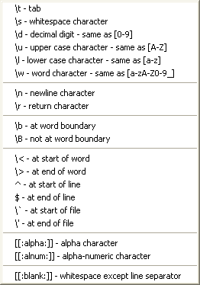
Regular Expressions
Selector helps to
write them live
Select from list or
Edit Expressions

Slide 22
Module Review
Narrowing Evidence Items
  KFF Management
  Fuzzy Hashing
  Checked Items
  Ignored / Privileged Items
Searching
  Indexed Search
  Import Lists
  Live Search
  Regular Expressions

Slide 23



